Slide 1
CPE 301 Project Presentation
Phillip Sortomme
Email: Sortop1@unlv.nvada.edu

Slide 2
AIM & ACCOMPLISHMENT
AIM:
Use PID control to operate a DC motor with encoder.
Use encoder to convert rotation of motor to convert to speed
Using USART receive instruction from user for motor speed
ACCOMPLISHMENT
Design of user interface with USART

Slide 3
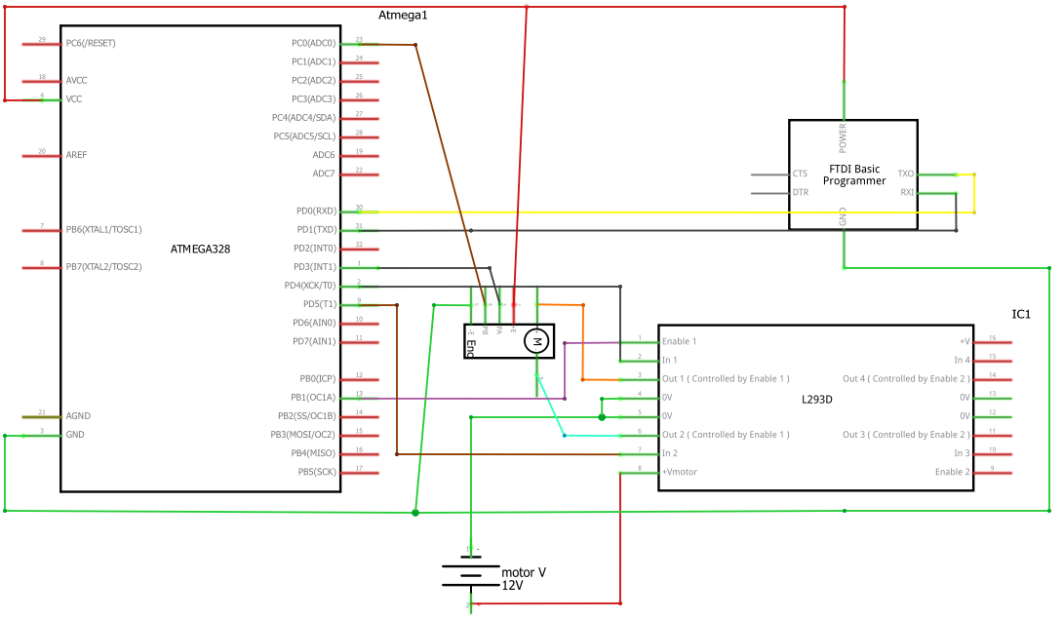
SCHEMATICS
Complete schematics

Slide 4
DESIGN STAGES
Components
AVR ATMEGA328p
Actobotics 195 RPM planetary gear DC motor with encoder
L293D half-H driver
FTDI breakout board
Interfaces
Atmega328p – DC motor with encoder –
Atmega328p - FTDI breakout board using USART-

Slide 5
CODE DEVELOPMENT
Initialization
designed USART transmit/ receive data.
designed functions to utilized received data
improved functionality to receive data through interrupts, freeing loop for computation
tested motor speed control using PWM
UNFINISHED: Implement PID control of motor using encoder data as speed reference
Data Collection
input from USART
UNFINISHED: motor rotation count via encoder
Networking/Visualization
none implemented

Slide 6
DEMO SNAPSHOT/VIDEO
circuit design implementation https://drive.google.com/open?id=1uparKXobRG1hbhrWyp3iZ6C2WNGryzDI
test output from USART https://drive.google.com/open?id=1coZexdgOvrwfS6thTiDBkJKUfftQfIPP

Slide 7
Group Projects
Student Name: Phillip Sortomme
Task Completed:
USART interface
Total circuit design
Contribution 100% towards the project:
Coding 100(%):
Implementation 100(%):
Testing/Demo 100(%):
Documentation 100(%):
Presentation 100(%):

